Slide 1
Day 3: Sharing plans, data and code
Anna Nowakowska, Mahmoud Elsherif, David Souto
School of Psychology and Vision Sciences

Slide 2
Open Scholarship: Pre-registration tutorial
Anna Nowakowska & Mahmoud Elsherif

Slide 3

The Reproducibility Crisis
Notes:
Reproducibility crisis is the finding, and related shift in academic culture and thinking, that a large proportion of scientific studies published across disciplines do not replicate (e.g. Open Science Collaboration, 2015). This is considered to be due to a lack of quality and integrity of research and publication practices, such as publication bias, QRPs and a lack of transparency, leading to an inflated rate of false positive results. Others have described this process as a ‘Credibility revolution’ towards improving these practices.
We are rewarded not for the right answer but career advancements through publications and grants. Rarely win a right answer-few will win a nobel prize, it is not robust and replicable. 5-10% of the findings are reproducible in psychology.
ongoing methodological crisis in which it has been found that many scientific studies are difficult or impossible to replicate or reproduce.
We are incentivised not only to find something as opposed to nothing, but also for the findings to be novel, eye-catching, groundbreaking. At Cambridge, Ottoline Leyser has this great quote, ‘We’re encouraged to do groundbreaking research, but what’s groundbreaking for? You break ground in order to build something, and if all you do is groundbreaking you end up with lots of holes in the ground.’ We’re incentivised to do the high-risk research, but not the foundational, corrective, replication research that builds the more robust edifice. It’s a bit like the situation we were in 10 years ago with the banking crisis… bankers were incentivised to go after the high-risk high-return investment and not the mundane stuff, and the cards eventually came crashing down.

Slide 4



Replicability in crisis
Notes:
While some claim that the failure to replicate is inescapable part of studying highly variable human behaviour and we should accept this uncertainty surrounding data, some scientists have shown the low replicability might be largely driven by suboptimal implementation of scientific methods: false positives or exaggerated effect sizes among the original studies, resulting from low statistical power, measurement problems, errors, selective reporting favouring original positive results, different analytic strategies, or questionable research practices.

Slide 5
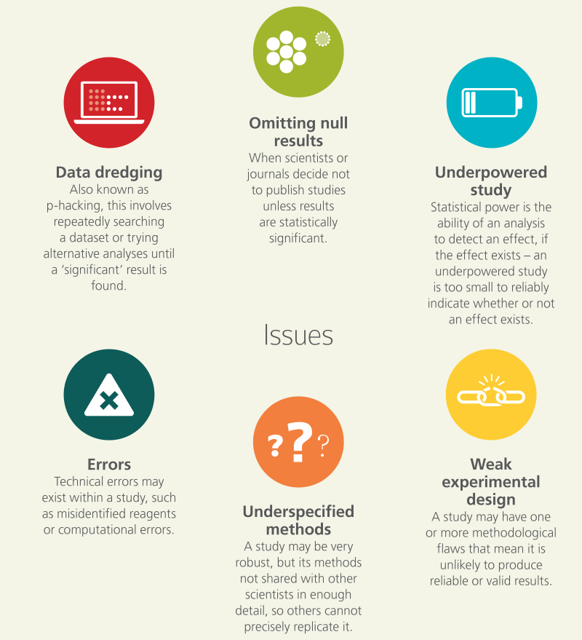
Questionable research practices
Notes:
What are the contributing factors for the reproducibility crisis- we should focus on the behaviours that are so commonplace not the ones that are only show up once. They have relatively impact on the study but they do impact the whole field a lot (analogous to smoking-individual level-modest and population-severe).
Some of us are fraudulent scientists, ideal and empirical but we are mostly in the middle.
We need to say a strong story, but maybe we should be detailing what is happening. We are not novelists but scientists.

Slide 6
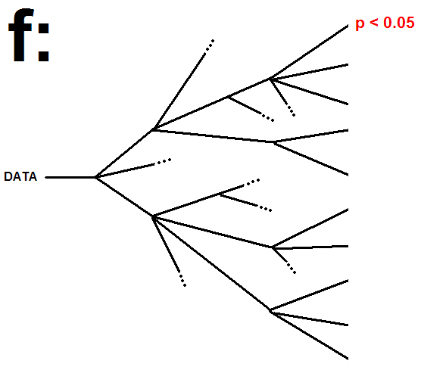
The Garden of forking paths (Gelman & Loken, 2013)
Notes:
We implicitly seek p < .05 to publish. We explore our data, it is not wrong to explore data, as long as you are transparent about it. It is pretty easy to find p < .05. We trace our path from p < .05 to how we got there, as if it was the original path taken not the path that was chosen from many paths taken. This can lead to replication failures and is one of many causes underlying the reproducibility crisis..

Slide 7
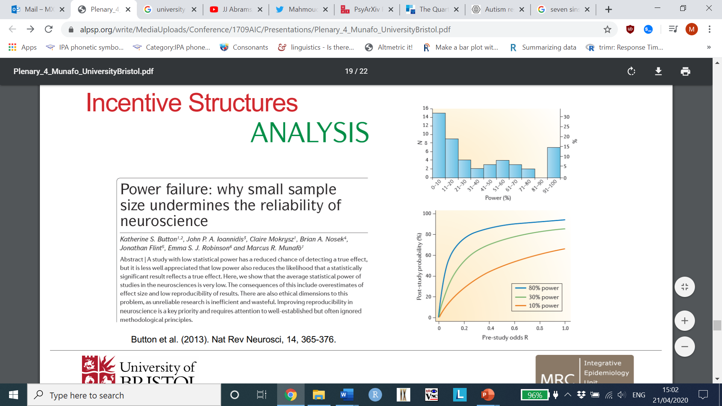
Incentive structure
Notes:
We have resources to strategically place it all in one study to get the right answer and be a good scientist. However, the answer may be uninsipiring or dull, with p value > .05, 10 studies less reliable, more likely p < .05. Roll dice 10 times or 1 time to get in right journal. What strategy makes sense for you as a scientist not for science? Are we incentivize in the right way?

Slide 8
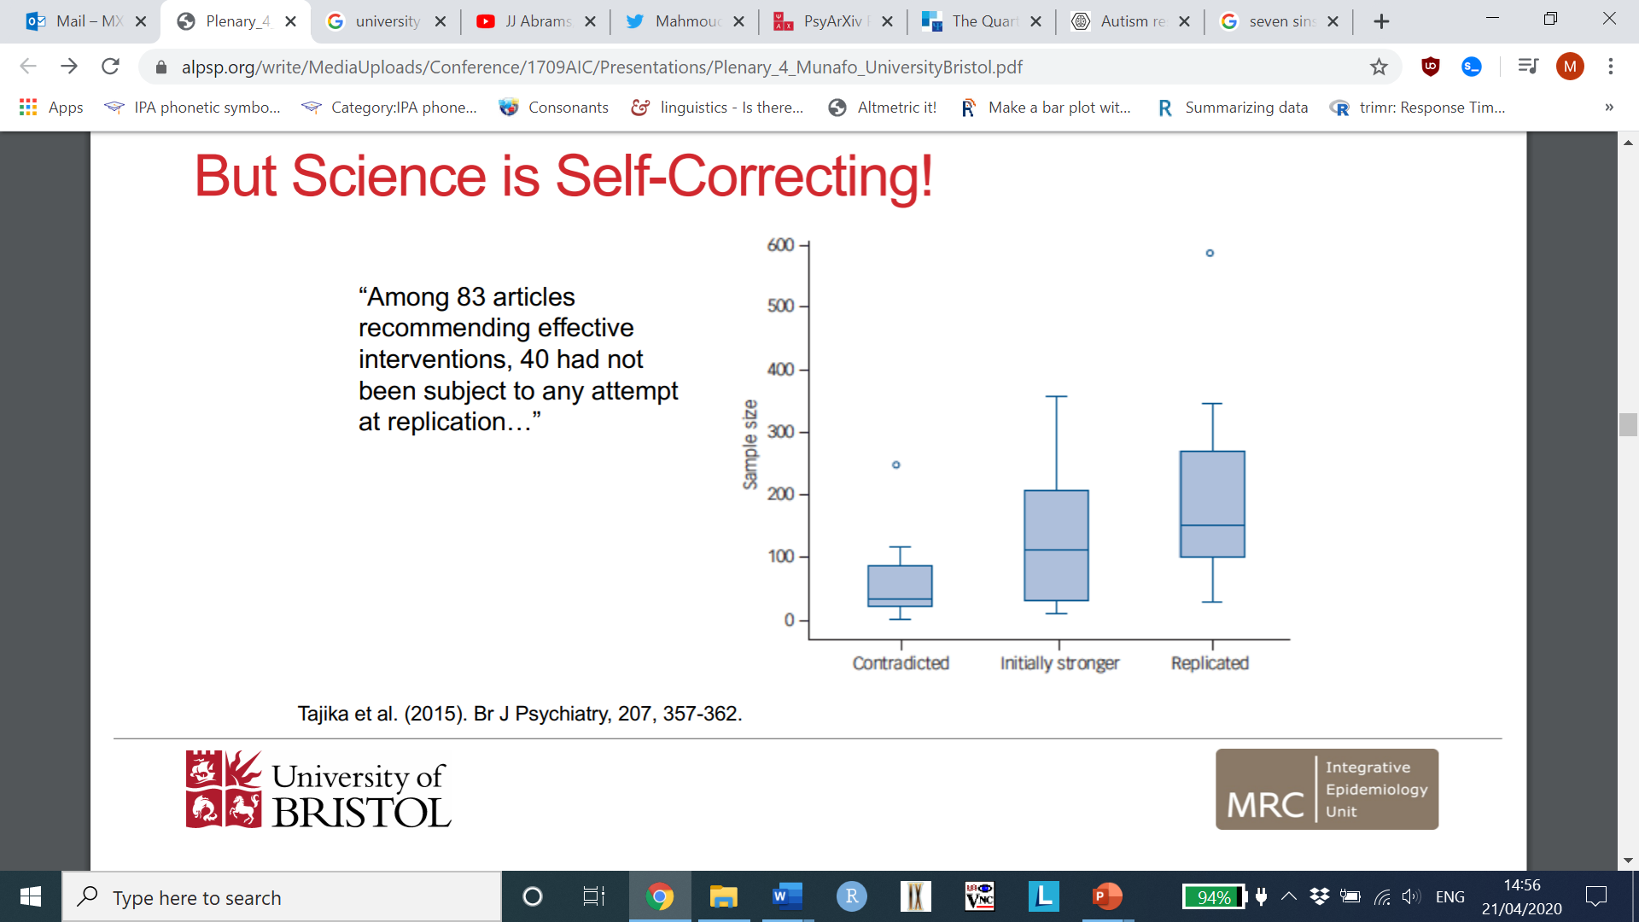

Science is self-correcting!
Notes:
To assess how highly cited studies in psychiatry are
replicated by subsequent studies. We selected highly cited studies claiming effective psychiatric
treatments in the years 2000 through 2002. For each of
these studies we searched for subsequent studies with a
better-controlled design, or with a similar design but a larger
sample.
Results
Among 83 articles recommending effective interventions,
40 had not been subject to any attempt at replication,
16 were contradicted, 11 were found to have substantially
smaller effects and only 16 were replicated. The
standardised mean differences of the initial studies were
overestimated by 132%. Studies with a total sample size of
100 or more tended to produce replicable results
Interventions at the end of the research pipeline. Interestingly, some did replicate, effect size is larger, some replication studies contradicted. Replication study-larger sample size was more likely give the same answer. Results more likely to give the correct answer to give more precise estimates or roll the dice as many times for career advancement.
Consider cognitive biases-issues of human behaviour-nice example two people will interpret it in different way support or contradicts it. Methodologists less likely to believe the data.

Slide 9
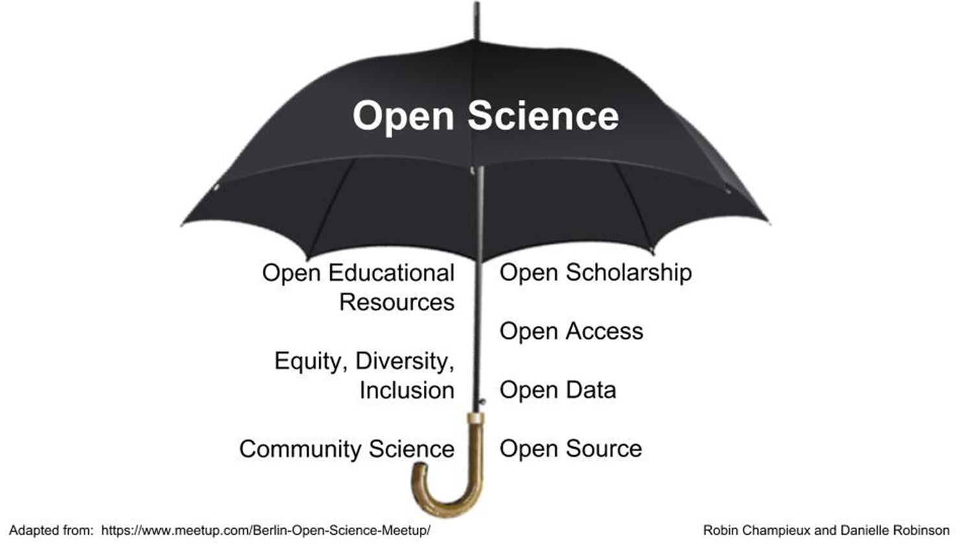
Solution: Open Science.
Open Science: openly accessible, transparent, rigorous, reproducible, replicable, accumulative, and inclusive,
Open science consists of principles and behaviors that promote transparent, credible, reproducible, and accessible science.
Open science has six major aspects: open data, open methodology, open source, open access, open peer review, and open educational resources.
Notes:
Open Science is an umbrella term reflecting the idea that scientific knowledge of all kinds, where appropriate, should be openly accessible, transparent, rigorous, reproducible, replicable, accumulative, and inclusive, all which are considered fundamental features of the scientific endeavour. Open science consists of principles and behaviors that promote transparent, credible, reproducible, and accessible science. Open science has six major aspects: open data, open methodology, open source, open access, open peer review, and open educational resources.
Open scholarship’ is often used synonymously with ‘open science’, but extends to all disciplines, drawing in those which might not traditionally identify as science-based. It reflects the idea that knowledge of all kinds should be openly shared, transparent, rigorous, reproducible, replicable, accumulative, and inclusive (allowing for all knowledge systems). Open scholarship includes all scholarly activities that are not solely limited to research such as teaching and pedagogy.

Slide 10
Pre-registration
The practice of publishing the plan for a study, including research questions/hypotheses, research design, data analysis before the data has been collected or examined.
Notes:
: The practice of publishing the plan for a study, including research questions/hypotheses, research design, data analysis before the data has been collected or examined. It is also possible to preregister secondary data analyses (Merten & Krypotos, 2019). A preregistration document is time-stamped and typically registered with an independent party (e.g., a repository) so that it can be publicly shared with others (possibly after an embargo period). Preregistration provides a transparent documentation of what was planned at a certain time point, and allows third parties to assess what changes may have occurred afterwards. The more detailed a preregistration is, the better third parties can assess these changes and with that the validity of the performed analyses. Preregistration aims to clearly distinguish confirmatory from exploratory research.

Slide 11
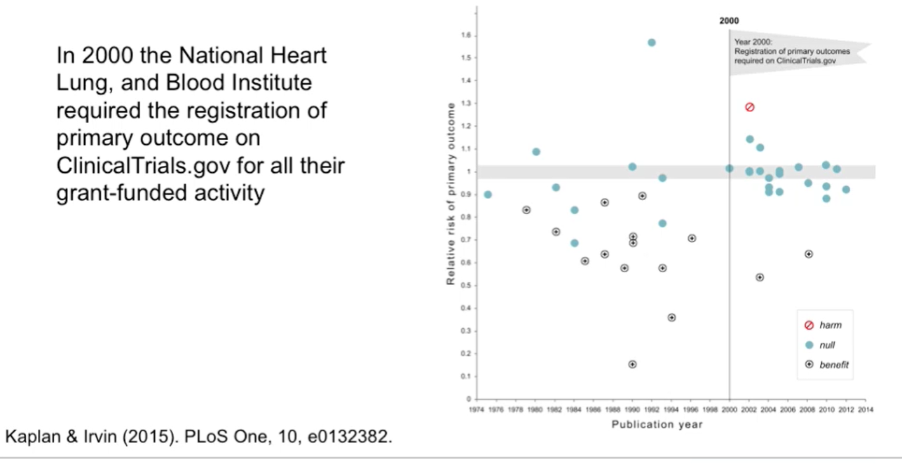
Notes:
We explore whether the number of null results in large National Heart Lung, and Blood Institute
(NHLBI) funded trials has increased over time. 17 of 30 studies (57%) published prior to 2000 showed a significant benefit of intervention
on the primary outcome in comparison to only 2 among the 25 (8%) trials published after
2000 (χ2=12.2,df= 1, p=0.0005). Pre-registration in clinical trials.
gov was strongly associated with the trend toward null findings.
Reduced reporting bias, clear distinction between exploratory and confirmatory research and prioritize theory and methods.

Slide 12
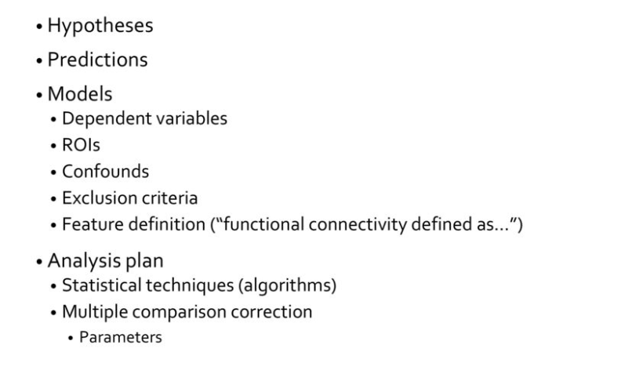
Pre-registration

Slide 13

Criteria of a good pre-registration
Measures: do they detail how the measure was constructed, merged, procedures and provide values that are operationalised (5 is neutral and 9 is unhappy).
Do they specify the model used with the variables included, data transformation, centre the data?
Do they provide the number of participants and when the data was collected?
Do they define why someone is included and excluded? How did they do it? What is the missing data and how was it taken care of?
Do they fulfil the statistical assumptions, how do they do it and is it dealt with?
What is the inference criteria?
No obligation to share data in pre-registration.
Notes:
Pre-registration can vary in quality, some do not detail the value, construction, model specification or procedures of the pre-registration. Also, detail how many participants you get and provide a sampling frame when you are going to collect it. Also, do not go beyond what is told because this is violating pre-registration.

Slide 14
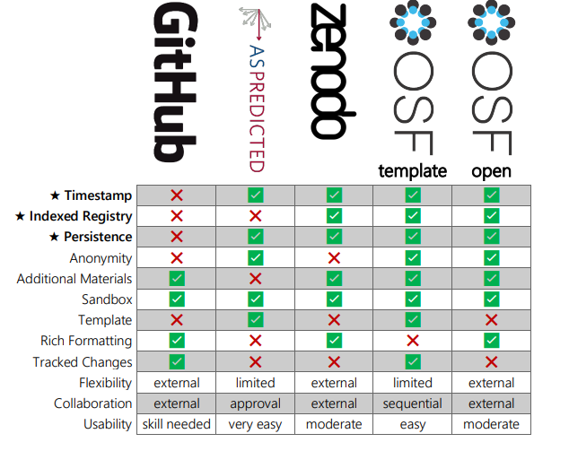
Platform for pre-registrations
https://osf.io/preprints/metaarxiv/zry2u_v1
1. Timestamp
2. Indexed Registry: It needs to eventually be indexed and searchable.
3. Persistence: unique identifier – such as a DOI.
5. Additional materials.
6. Sandbox
7. Template
8. Rich Formatting
9. Tracked changes
10. Flexibility: If there is a template, can you skip a question or add a question?
11. Collaboration: can everyone edit or proofread the preregistration?
12. Usability: Quality of life and avoiding frustration for novices and experts.
Notes:
1. Timestamp: Without an immutable timestamp, a platform is not appropriate for preregistration.
2. Indexed Registry: It needs to eventually be indexed and searchable. Even if a preregistration were deleted, the author list and a note would be left behind. Without indexed registration, a platform is prone to “preregistration hacking”.
3. Persistence: A preregistration will be referenced from the eventual writeup, so persistence of the content and of an immutable unique identifier – such as a DOI – is critical to ensure that it does not suffer from “link rot”. Otherwise, a preregistration may be not visible to future readers of the publication.
4. Anonymity (private/public)
5. Additional materials: Can you include analysis scripts, experiment materials, or pilot data along with the preregistration? Including an analysis as part of a preregistration can be especially helpful in showing that all of the detailed decisions were determined a priori.
6. Sandbox: you can try out the process and features without it being indexed or leaving a permanent record.
7. Template: Does the site have one or more templates to choose from or that it links to?
8. Rich Formatting: Can styled text, bulleted lists, and figures be used in the pre-registrationfor writing?
9. Tracked changes: If the preregistration is updated or a deviation needs to be documented, is it clear that an update occurred? Can the changes be documented? Is there some sort of “diff” to show what changed?
10. Flexibility: If there is a template, can you skip a question, add a question, or otherwise deviate from the specified fields?
11. Collaboration: On projects with multiple authors, can everyone edit or proofread the preregistration before it is filed?
12. Usability: Quality of life and avoiding frustration for novices and experts are important.

Slide 15
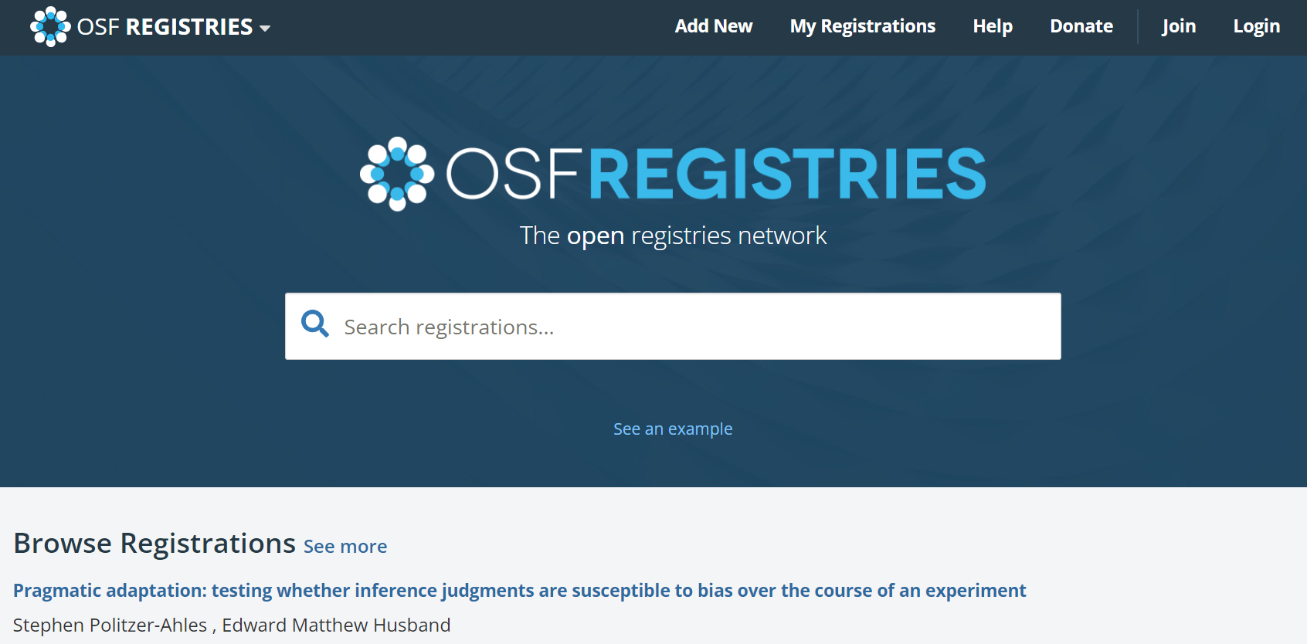
Tutorial
Go to https://osf.io/registries/
Login or create new registration

Slide 16

Add new registry

Slide 17
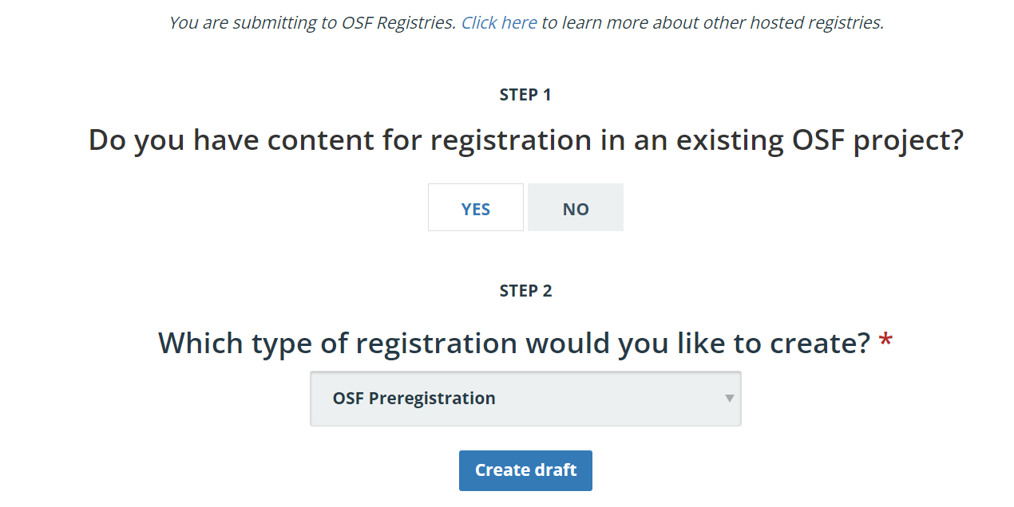
Creating pre-registration
Notes:
Different types: registered report, qualitative, secondary data, primary, replication and so on.

Slide 18
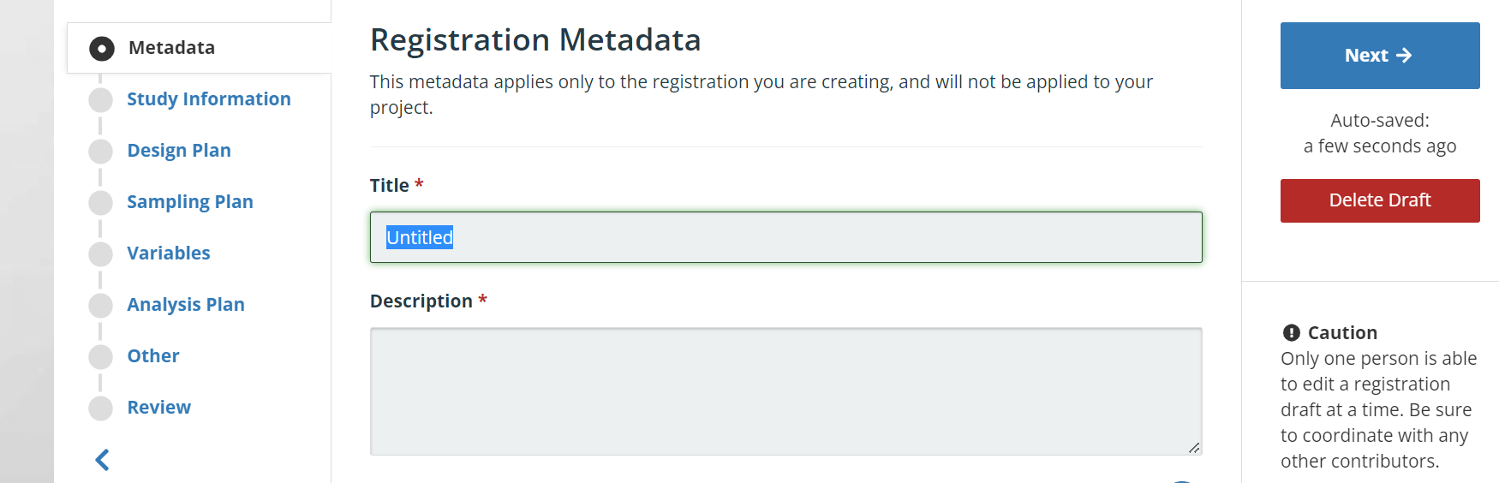
Registration Metadata
Notes:
Evidence has supported the idea that readers lexically process words serially (one at a time), but evidence by Mirault et al. (2018) has demonstrated a transposed word effect. This effect is where readers have difficulty deciding that sentences such as “do love you me? “are ungrammatical, in which the transposition of two adjacent words (i.e., love you) would form a grammatical sentence, compared to sentences in which the transposition of two words does not result in grammaticality (e.g. the cat white was slowly). This has been taken as evidence for the parallel lexical processing of multiple words simultaneously. Evidence has also shown that the transposed word effect can be attributed to a combination of noisy bottom-up word position coding and top-down syntactic constraints. This effect can be interpreted within serial, as opposed to parallel, reading models. Nevertheless, the present study will examine the transposed word effect with rapid serial visual presentation, in which we present the sentences in a word-by-word manner at a very fast sequential rate (i.e. 125ms) or slower rate (i.e.250ms) to test specific predictions of a serial processing account of the transposed word effect by manipulating sentence type and RSVP.

Slide 19
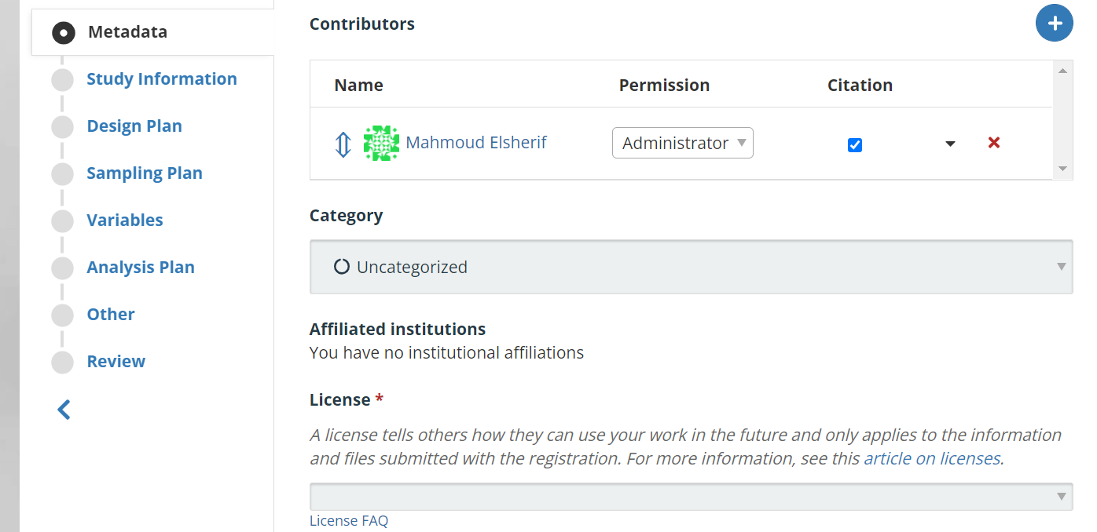
Metadata
Notes:
Categories include data, other, software, analysis

Slide 20
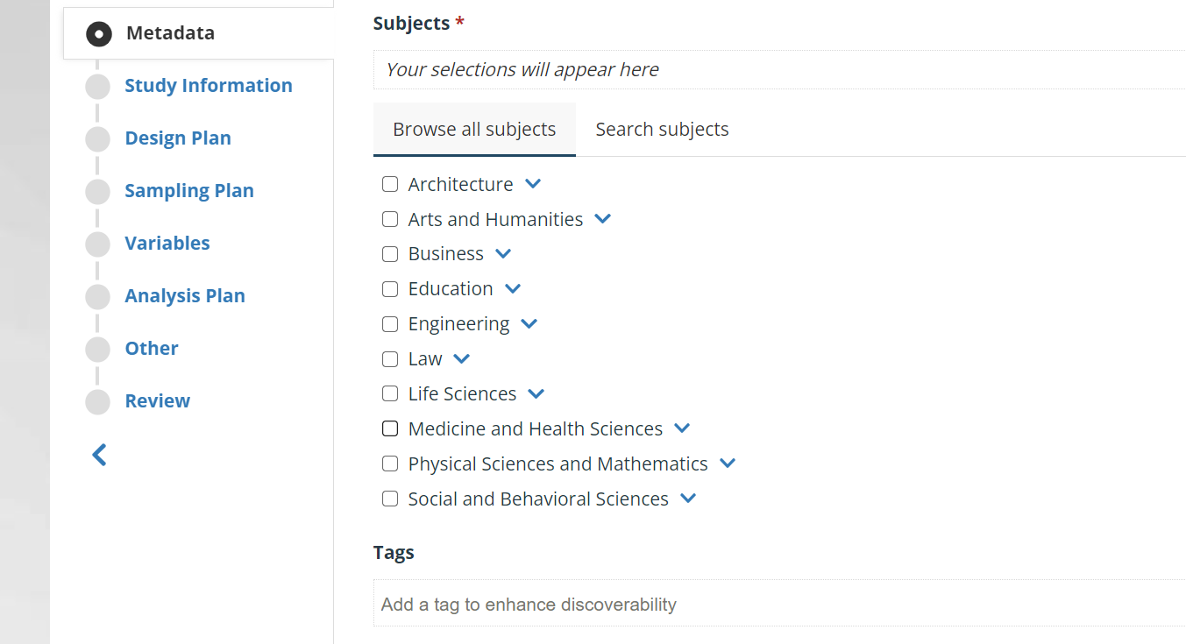
Preregistration disciplines

Slide 21
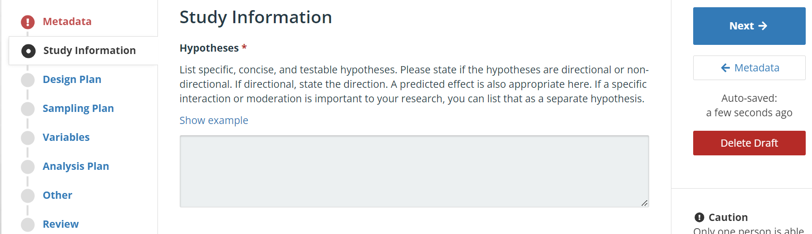
Study information
Notes:
Hypothesis: 1) we predict that participants will respond to items presented at 250ms per word more quickly and accurately than items presented at 125ms per word during RSVP. 2) we predict that sentences which are ungrammatical due only to a word transposition (e.g. He watched old an movie last time) would take longer to respond to and be responded to less accurately than grammatical sentences (e.g. He watched an old movie last time). 3) we predict a transposed word effect such that the sentences which are ungrammatical due only to a word transposition (e.g. He watched old an movie last time) would take longer to respond to and result in more errors than ungrammatical sentences with the final word being replaced (He watched old an movie last help). 4) We predict that there should be an interaction between RSVP duration and sentence type, such that we should see a larger transposed word effect in 125ms than 250ms RSVP duration.

Slide 22
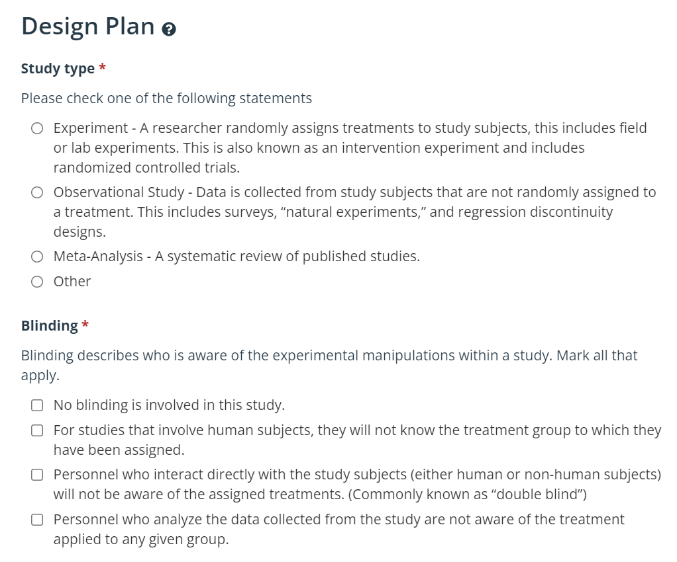
Design plan

Slide 23
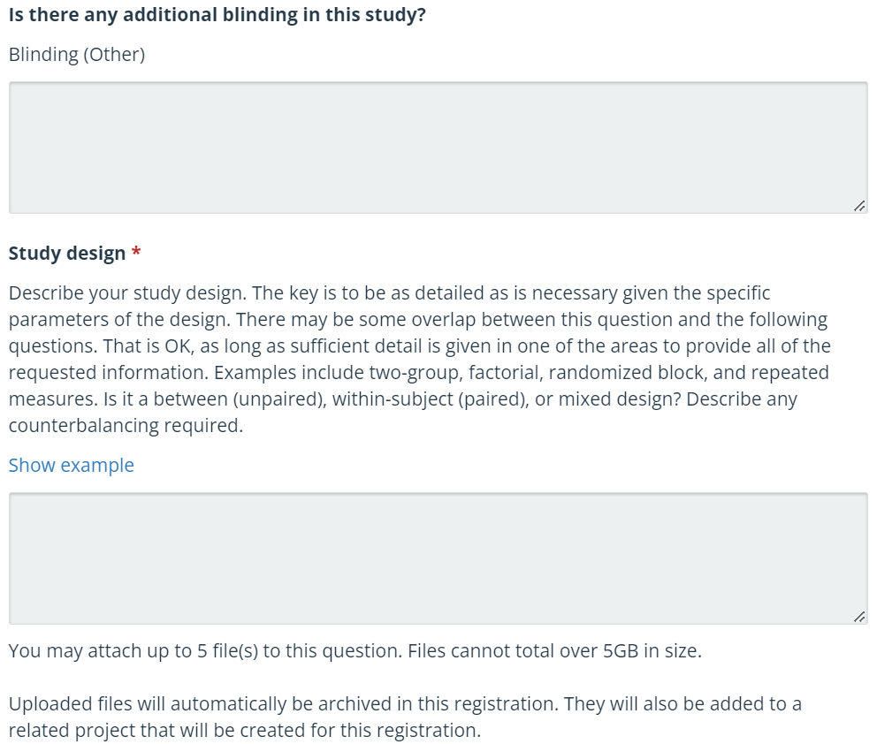
Design plan
Notes:
We hired a RA to do our analyses who were blind to the aims and hypotheses of study.
Measures: do they detail how the measure was constructed, merged, procedures and provide values that are operationalised (5 is neutral and 9 is unhappy).
We have a within-subject design with two factors (Sequence Type and RSVP), Sequence Type has three levels and RSVP has two levels. The three levels of Sequence Type are: transposed, ungrammatical control, and correct. However, it should be noted that the ‘correct’ condition consists of a separate set of items to the other two conditions. This condition is primarily present so that there are an equal number of grammatical and ungrammatical items throughout the experiment, to prevent participants from simply responding “ungrammatical” to every single item. This is a perfectly standard part of the design for studies on the transposed word effect. Thus, for analysis purposes Sequence Type actually only has two conditions, with these being the sentences featuring only transposed words and the ungrammatical controls. The two levels of RSVP are: 125ms and 250ms. An equal number of items are presented in each of our four conditions which form our analysis. Each item will be seen in each condition an equal number of times across participants, using four experimental lists.

Slide 24
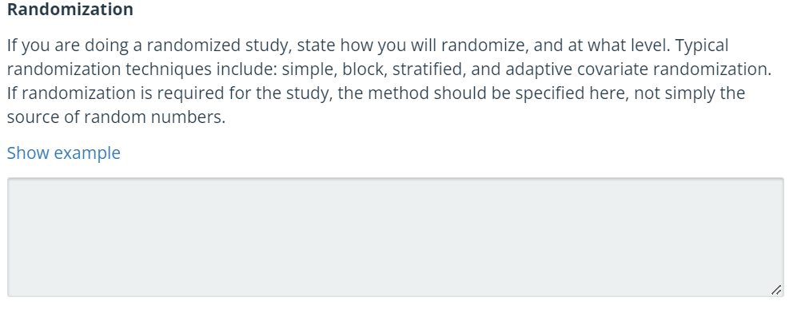
Randomisation
Notes:
Items are randomised within the block. Items are pseudorandomised concerning the RSVP and the condition of transposed or control.

Slide 25
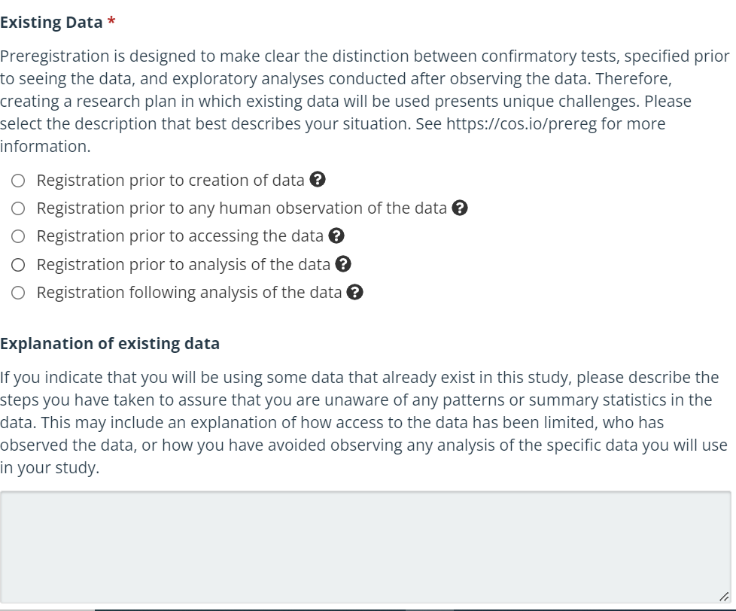
Sampling plan

Slide 26
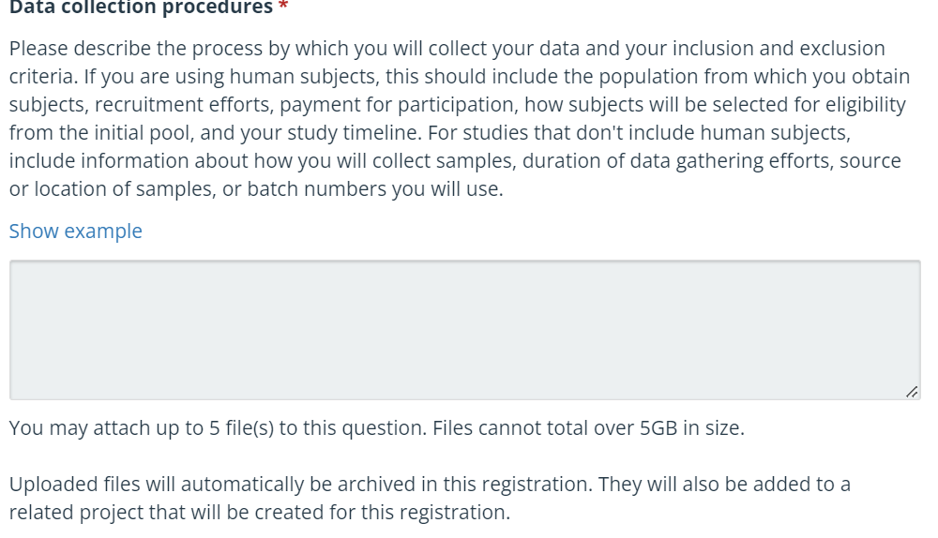
Sampling plan
Notes:
Participants will be recruited using the Gorilla and Prolific interface. They will also receive reimbursement at a rate equivalent to £9 per hour. Participants must be 18 years old, with native English as their only proficient language, must not have dyslexia, and have normal/corrected vision.

Slide 27
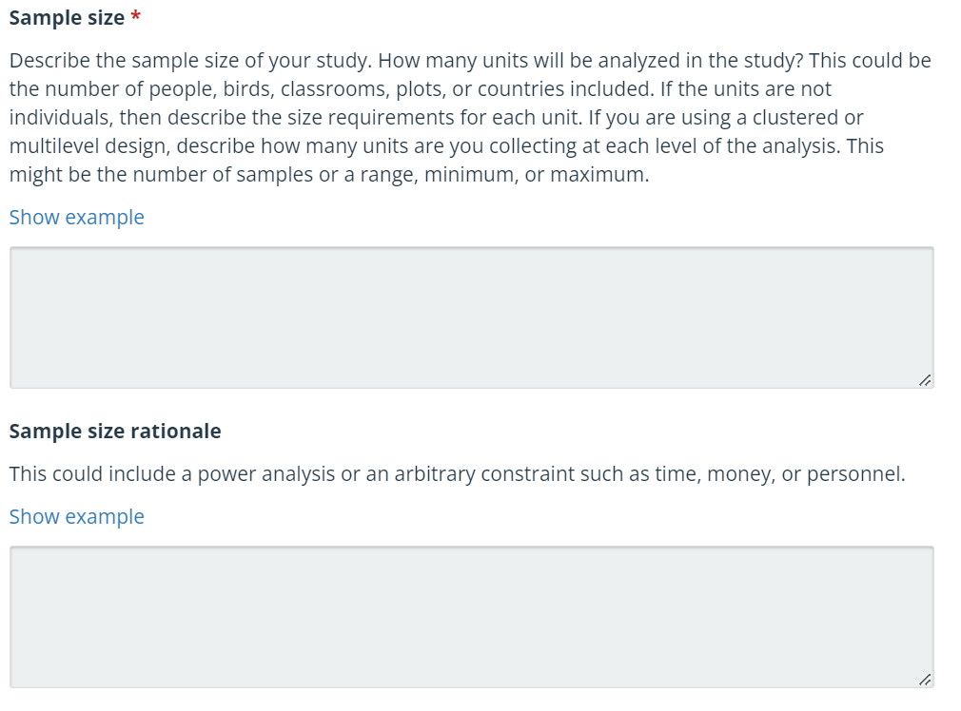
Sampling plan
Notes:
Do they provide the number of participants and when the data was collected? We will collect data from at least 300 participants. In the manuscript, we collected three-hundred and ten participants- that is something you do not do. Think of it as a contract.
Sample size
Our target sample size is 62 participants.
Sample size rationale
Our target sample size is a minimum of 1600 data points per cell of the experimental design. We will therefore recruit 62 participants to complete the study, who will each respond to 56 grammatical correct sentences per RSVP condition, equating to 3,472 observations per cell before data exclusion. In addition, participants will each respond to 28 ungrammatical sentences per condition, equating to 1,736 observations per condition for each of the four conditions. This will provide enough observations to allow us to assess the interaction between RSVP and condition.

Slide 28
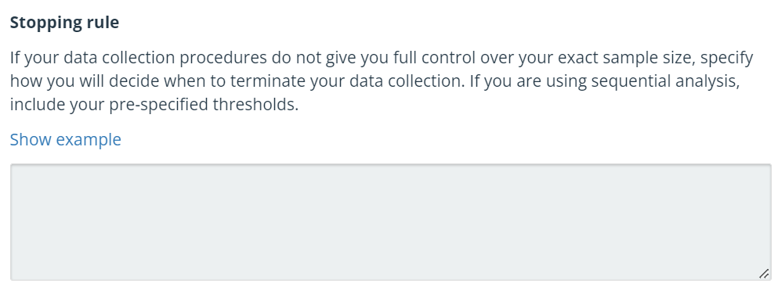
Sampling plan
Notes:
62 participants. If participants need to be excluded (e.g. because their accuracy in the grammatically correct condition is too low, see Data Exclusion section), they will be replaced to ensure that the final data set has 62 participants.

Slide 29
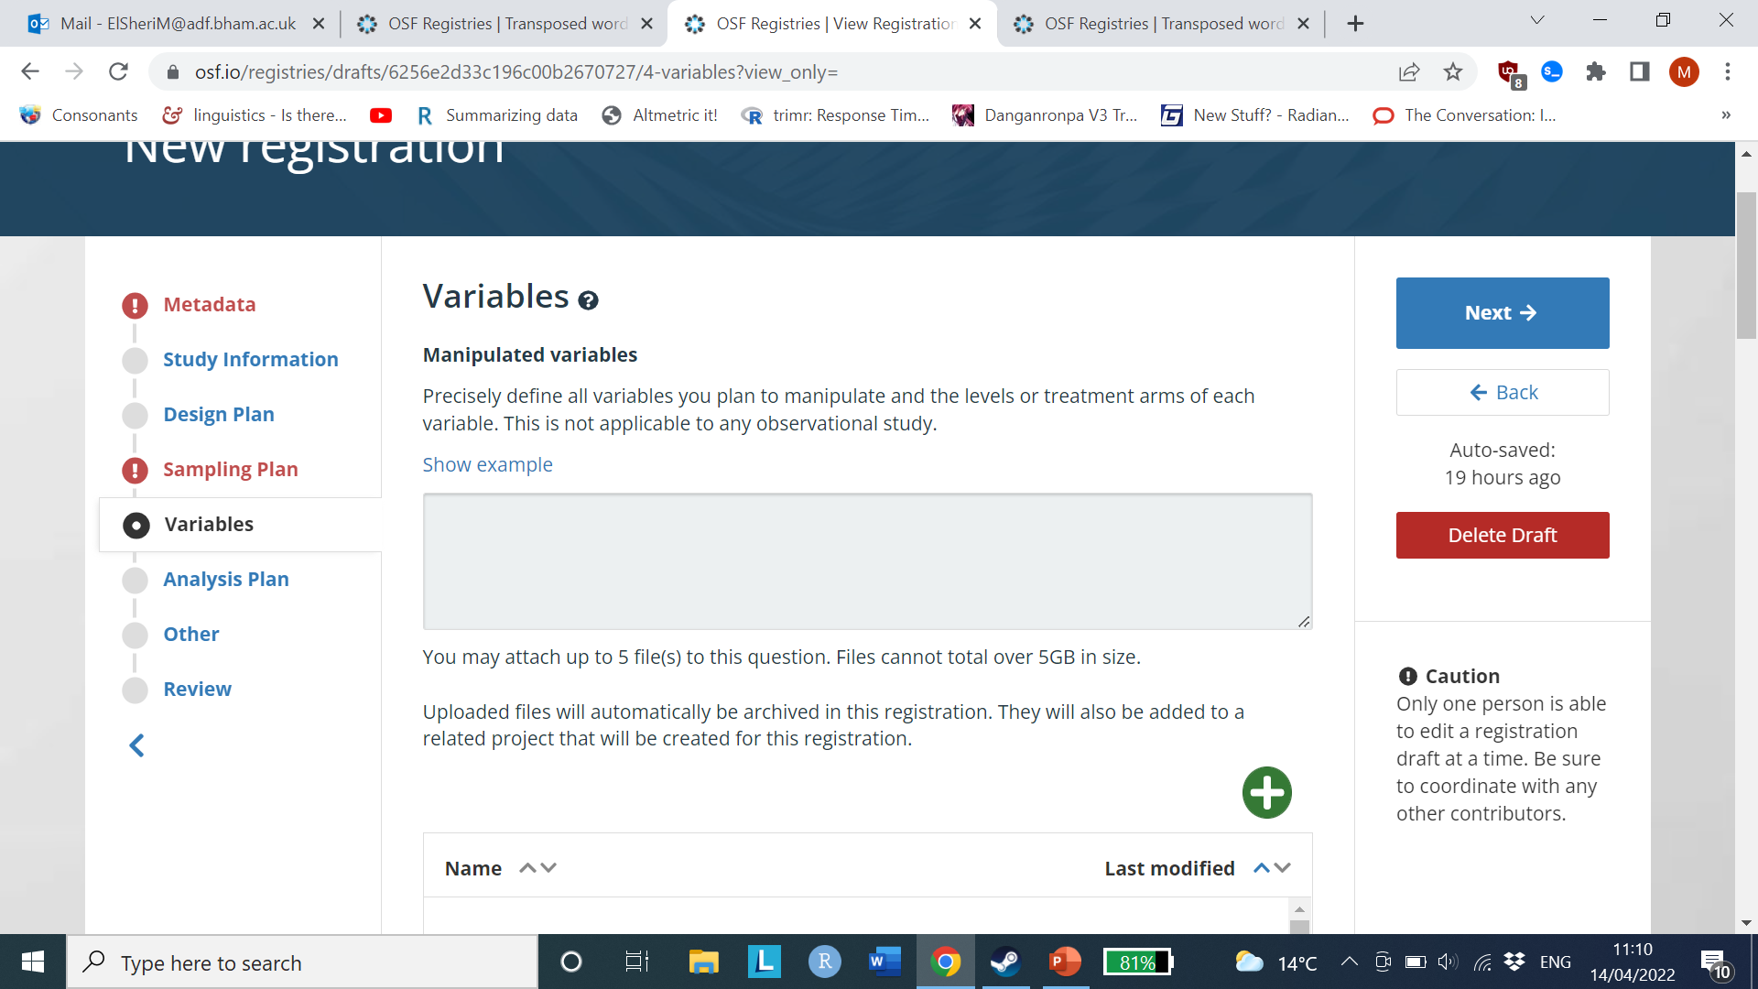
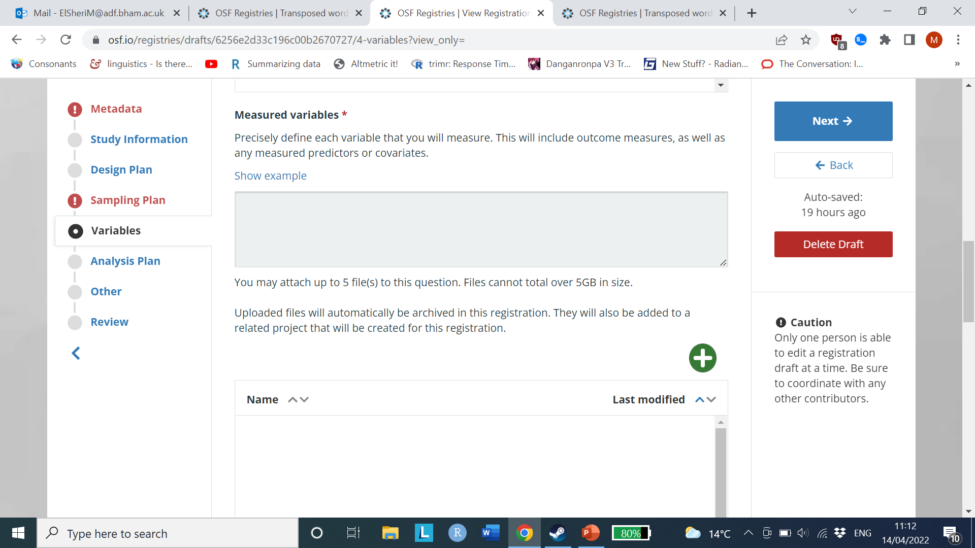
Variables
Notes:
Measures: do they detail how the measure was constructed, merged, procedures and provide values that are operationalised (5 is neutral and 9 is unhappy).
We used a factorial design and included the following variables; Target Duration (125-250, 250-125) and Sequence Type (baseline, control and transposed). Once again, the baseline was present to make it so there were an even number of grammatical and ungrammatical items throughout the experiment. Control, baseline vs transposed: The baseline was a grammatically correct sentence that was used as filler (e.g. the worried man was nervous and shy). Transposed: The ungrammatical word strings were created by transposing two adjacent words in a grammatical base sentence (e.g. “The folks wish for a better time” became “the folks for wish a better time”, with bold underlines highlighting the transposed words). Control: The control items were created by transposing two words in an ungrammatical base sentence in which the final word from a grammatical sentence was replaced with another word (e.g. “The folks wish for a better time” became “the folks for wish a better woods”, with ”woods” making the sentence ungrammatical regardless of the transposition of “wish” and “for”). 125-250 vs. 250-125: Stimuli will be presented centrally, one word at a time, using RSVP. In the 125-250 condition the first word in the transposed pair is presented for 125ms and the second is presented for 250ms. In the 250-125 condition, the first word in the transposed pair is presented for 250ms and the second is presented for 125ms. Examples are shown below. In each example the time that each word is presented for is shown immediately after the word in brackets. Transposed, 125-250 The(250ms) folks(250ms) for(125ms) wish(250ms) a(250ms) better(250ms) time.(250ms) Transposed, 250-125 The(250ms) folks(250ms) for(250ms) wish(125ms) a(250ms) better(250ms) time.(250ms) Control, 125-250 The(250ms) folks(250ms) for(125ms) wish(250ms) a(250ms) better(250ms) woods.(250ms) Control, 250-125 The(250ms) folks(250ms) for(250ms) wish(125ms) a(250ms) better(250ms) woods.(250ms)
The outcome variables will be 1) the raw reaction times of correct answers only and 2) accuracy in the grammatical decision task. Raw reaction times will be transformed into log and inverse reaction times in order to fulfil statistical assumptions such as the residuals of the reaction time being normally distributed and the pattern linear (Meteyard & Davis, 2020). The main analysis used will be the inverse reaction time, as it has been argued to be the best analysis for reaction time data and is seen as a more statistically powerful transformation compared to no transformations and log transformations (Brysbaert & Stevens, 2018). However, to ensure our effects do not result from transformation, we will include the model being conducted with raw and log transformations on reaction time to see if any differences emerge. These will be presented as supplementary analyses.

Slide 30
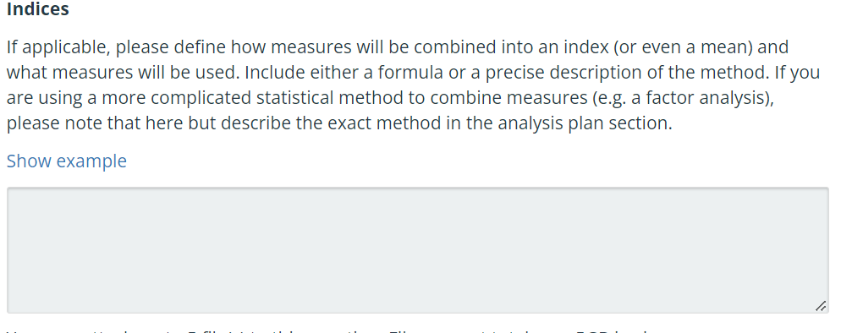
Indices

Slide 31
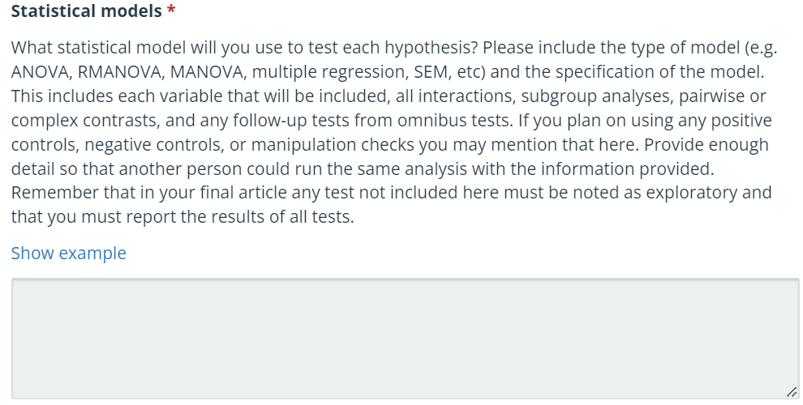
Analysis plan
Notes:
Do they specify the model used with the variables included, data transformation, centre the data?
A general linear mixed model (GLMM) will be used to analyse reaction times and accuracy, using the lme4 package in R. Significance is set at α = 0.05 and if the t values are above 2, the p value is significant (Baayen et al., 2008). The GLMM is conducted on accuracy, as linear regression coefficients are directly interpretable when interactions or fixed effects are included, making GLMM safer to use. In addition, a linear model will be used as opposed to using a general logistic mixed model since the former produces unbiased estimates of effects on binary outcomes (Gomila, 2020). In the event that we fail to replicate the standard transposed word effect in our initial analysis of the accuracy data, we will re-analyse this data using the type of model that has been used in prior investigations of this phenomenon (i.e. logistic) in order to ensure that the difference between our work and prior studies is not simply due to the use of different statistical approaches Statistical analyses were performed only on the data concerning the ungrammatical sequences, thus the fixed effects are effects of Sequence Type (transposed and control); RSVP (125, 250ms); and the interaction of Sequence Type and RSVP. The contrasts conducted on each fixed effect will be sum-coded to make coefficients directly interpretable. In addition, the random effects will be an item and subject slope with condition and RSVP being included in the random model (see below): accuracy ~ 1 + SequenceType * RSVP +(1 + SequenceType*RSVP |Subject) + (1 + RSVP*SequenceType |item). RT ~ 1 + SequenceType * RSVP +(1 + SequenceType*RSVP |Subject) + (1 + RSVP*SequenceType |item). logRT ~ 1 + SequenceType * RSVP +(1 + SequenceType*RSVP |Subject) + (1 + RSVP*SequenceType |item) invRT ~ 1 + SequenceType * RSVP +(1 + SequenceType*RSVP |Subject) + (1 + RSVP*SequenceType |item). In all cases, the maximal random structure model will include the interaction of both conditions with both subjects and items (Barr et al., 2013). A fully random model is used whenever possible. However, fully specified models often fail to converge. If the model fails to converge, we will simplify the random slopes, removing interactions before main effects in the order of least variance explained until the model converges (Veldre & Andrews, 2014).
You could also split the analyses up into different analyses to examine key research questions but provide key details as to how they may differ. For instance, analysis one, looks at accuracy, we will transform it here but not for analysis two because of XXXX.

Slide 32
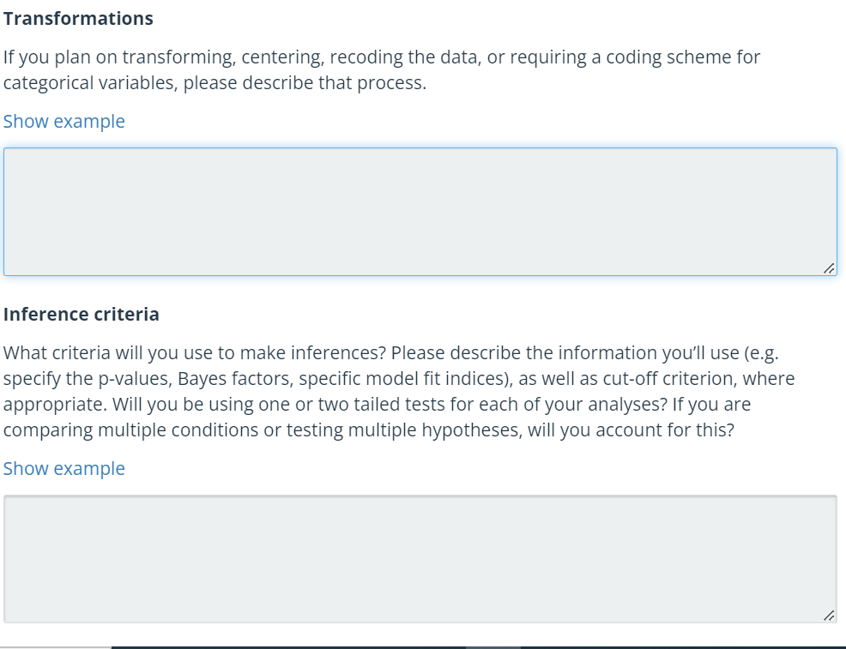
Analysis plan
Notes:
Do they specify the model used with the variables included, data transformation, centre the data?
Do they fulfil the statistical assumptions, how do they do it and is it dealt with? Something important is how are you going to fulfil your statistical assumptions, it is dangerous in my eyes for psychologists not to do this, you cannot infer what the results mean, if this is the case. We make too many assumptions that our residuals of normal distribution is normal distributed when it may not be.
Transformations
The main analysis will be conducted on inverse-transformed RT to meet the normality and linearity requirements of linear-mixed models. Parallel analyses will be conducted on untransformed and log-RT to assess whether the results depend on transformation.
What is the inference criteria?
Inference criteria
We will use the standard p <.05 criteria, using t values must be above 2. In addition, to further assess whether the non-significant effect indeed supports the null hypothesis, we will calculate the Bayes factor, using ‘BayesFactor’ package in R (see Rouder et al., 2012 for details). This result will provide evidence in favour of the null hypothesis. The BF must be below 1/3 to argue in favour of the null hypothesis.
Alpha will be set to .05. BF,

Slide 33
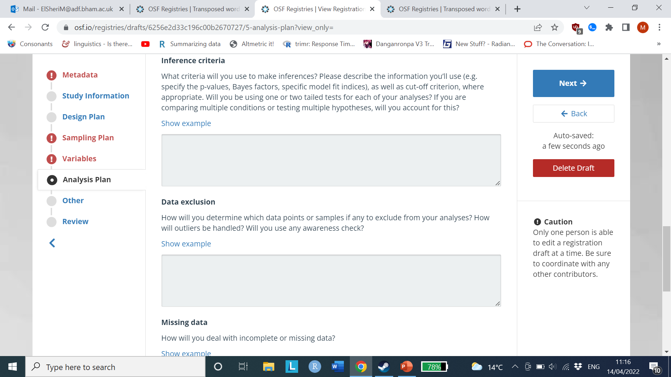
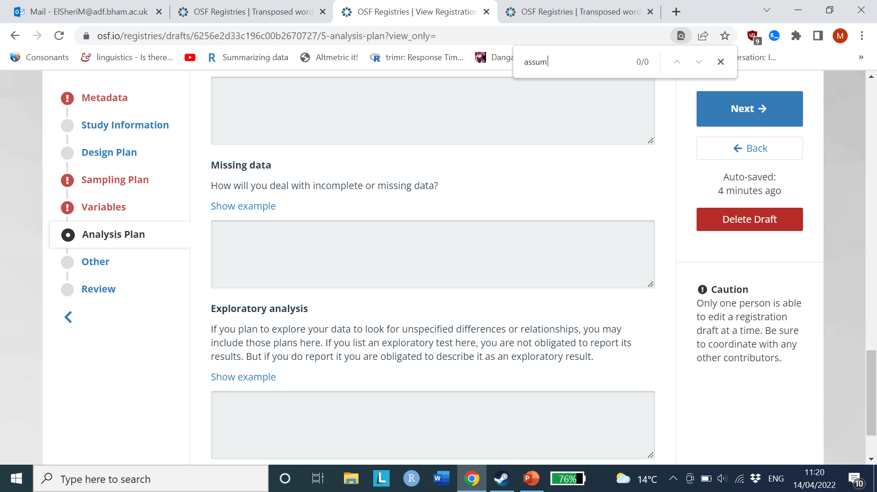
Analysis plan
Notes:
Do they define why someone is included and excluded? How did they do it? What is the missing data and how was it taken care of?
Explain inclusion and exclusion criteria:
To qualify, participants must be 19 years of age or older and meet AT LEAST ONE of the following criteria:
1. Have committed a SERIOUS CRIMINAL OFFENSE (e.g. violent crime, drug related offenses, sexual offenses, robbery, motor vehicle theft, etc.) within the past 5 years.
2. Have engaged in EXTENSIVE illegal activity within the past 5 years.
Participants will be excluded if they meet one or both of the following criteria:
a) their criminal history (reported on LeBlanc and FrÃ©chetteâ€™s (1989) validated criminal checklist) at the beginning and end of the survey do not match.
b) they "opt-out" of purchasing an item for charity in the prosocial spending condition. In other words, if participants randomly assigned to the prosocial spending condition choose to take the nominal sum (i.e. 5 cents) for themselves as opposed to purchase an item for charity.
If a participant does not complete the key dependent variable (PA), that participant will not be included in the analysis.
Missing data
Data partially missing because participant quit study halfway through will be excluded; if applicable, data partially missing due to unforeseen software errors will be included in the main categorical analyses. However, to ensure we obtain additional observations due to unforeseen software errors, we will use multiple imputation (Woods et al., 2021). In addition, we will investigate any item responses resulting from missing data not at random. For instance, if only 10% of participants respond incorrectly to some items, while a few other items are responded to incorrectly by around 60% of participants, then we will discuss why this may have happened which may lead to additional exploratory analyses (Woods et al., 2021).

Slide 34
Deviations
Any deviations, say it. You used incorrect method or method found to be wrong, say it.
Be honest and transparent.

Slide 35
Examples
https://osf.io/r5bjm : transposed word and RSVP
https://osf.io/vh3gm: East Africa Policy
Different format:
https://osf.io/72hkg/files/osfstorage : decision making and visual search

Slide 36
Exercise: Write a pre-registration based on the paper below
https://link.springer.com/article/10.1007/s40979-024-00158-3

Slide 37
Actual pre-registration
https://aspredicted.org/mk3a2.pdf

Slide 38
Questions?

